Slide 1

IE 260 – ENGINEERING ECONOMY Course Content & Syllabus
U. MAHİR YILDIRIM

Slide 2

Expectations?

Slide 3
Syllabus
Course Learning Outcomes:
Develop an understanding of basic concepts of Engineering Economy.
Evaluate the profit of a firm, carry out the breakeven analysis and employ this tool to make production decision.
Describe time value of money, economic equivalence, and cash flow.
Calculate common capital appraisal techniques such as NPV, IRR, Payback period.
Use capital appraisal techniques to compare among alternatives and determine the most profitable alternative.
Perform benefit-cost analysis.

Slide 4
Syllabus (cont’d)
Requirements
Attendance is required. Students participating less than 70% of lecture and class hours (separately) will not be eligible to take the final exam.
The overall average must be at least 40 for the course to be able to get a passing grade.
Excused absences must be documented and is subject to instructor evaluation for legitimacy.
Adherence to the University Academic Integrity policy is expected

Slide 5
Syllabus (cont’d)
Instructor : U. Mahir Yıldırım
Teaching Assistant : Onur Yılmaz
Keep in touch
Always get in contact with us before it is too late!
To: mahir.yildirim@bilgi.edu.tr / bilgi.onuryilmaz@gmail.com
Subject: IE 260 - …
Office hours will be announced.
Check your bilgi e-mail account regularly
Check Blackboard module regularly

Slide 6
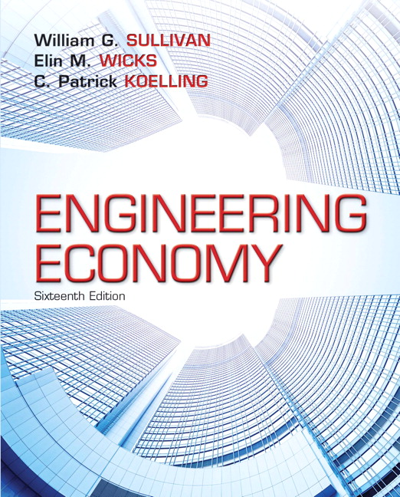
Syllabus (cont’d)
Required text
Engineering Economy
Sullivan W., Wicks E., Koeling C.
Additional Readings
Fundamentals of Engineering Economics, Park C.S.
• Engineering Economy, Blank L, Tarquin A.,

Slide 7
Syllabus (cont’d)
Exams and Grading:
Your quizzes will be online on Blackboard.
You will have individual homework assignments.
Evaluation Type | Number | Points (each) | Percentage (total)
Homework Assignments | 6 | 100 | 30
Online Quizzes | 2 | 100 | 10
Midterm | 1 | 100 | 25
Final | 1 | 100 | 35
TOTAL |  |  | 100

Slide 8
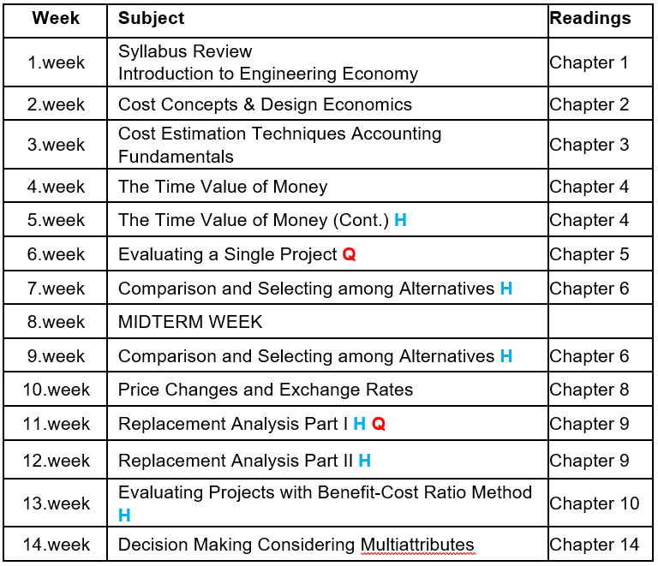
Tentative Lecture Schedule

Slide 9
Previous Semester Statistics
FF : 13.0 % - Yes, attendance matters !
F (excluding FF's) : 13.6 %
E Exam
Only some of those who get F can take the exam

